Slide 1
Chapter 54 Sections 54.1 and 54.2
Relationships in Ecosystems
Structures of Ecosystems
Components of Structures

Slide 2
Overview
Chapter 54 focuses on interactions between species in a community, determining their structure, and application of the principles of community ecology to human disease.
Sections 54.1 and 54.2 focuses on the interactions in the community, their effects, community structure, structural models, and components of said structure.
In this PowerPoint presentation, the word "parties” usually refer to individuals from two different species.
Focus on orange text.

Slide 3
General Ecology Terms
A population is a group of individuals of one species living in one area who have the ability of interbreeding and interacting with each other.
Example: Populations of humans, populations of black oaks, and populations of the bacteria Streptococcus pneumoniae.
A community consists of all the organisms living in one area.
An ecosystem includes all the organisms in a given area and the abiotic (nonliving) factors with which they interact.
Abiotic factors are nonliving and include temperature, water, sunlight, wind, rocks, and soil.
The habitat of an organism is the type of place where it usually lives. A description of the habitat may include other organisms that live there (often the dominant vegetation) as well as the physical and chemical characteristics of the environment (such as temperature, soil quality, or water salinity).

Slide 4
54.1: Community Interactions and Effects
Interspecific interactions - Interactions of individuals in one species with individuals of another.
Types of interactions: Competition, predation, herbivory, symbiosis (including parasitism, mutualism, and commensalism), and facilitation.
A + symbol indicates positive effect, - symbol indicates negative effect, 0 indicates no effect.
+/- means positive effect for one party results in a negative for the other.
+/+ means both parties benefits.
0s are rare in the real world, as individuals of species usually have some sort of effect, no matter how small.
Studies have historically focused on interactions resulting in negative effects for at least one of the two individuals in a species, but now, positive (facilitative/commensalism/mutualism) interactions are what we’re focusing on in modern times.

Slide 5
Community Interactions - Competition
Interspecific Competition - -/- interaction where both parties compete for non-abundant resources that both need to survive. They can’t coexist if their niche (role) is identical.
Example: Weed and garden plants need soil nutrients.
Very abundant resources such as oxygen don’t count as part of interspecific competition.
Competitive Exclusion / Gause’s Principle - When interspecific competition occurs, one of two parties will die out because one of them is superior in attaining and utilizing resources.

Slide 6
Niche and Natural Selection
Ecological Niche - How a species uses their environment (abiotic and biotic factors). Basically, their role in the environment.
If two species occupies a certain niche, they cannot coexist.
Fundamental Niche - The potential for a species role in their environment
Realized Niche - What they actually do out of their fundamental niche.
Fundamental Niches can be tested for in a noncompetitive environment, with realized niches then be tested for in a competitive environment.
Resource Partitioning - Two species who didn’t coexist before can coexist if they evolve and differentiate their niches (roles).
Indirect evidence that interspecific competition existed before.
Differentiation of niches doesn’t need to mean different resources, two species can use the same resources at different times of day too.
Example: Common spiny mouse hunts at night, golden spiny mouse hunts at day. Golden one is actually naturally nocturnal, but it hunts during the day as an adaptation around the common spiny mouse.

Slide 7
Niche and Natural Selection
Character Displacement (niche shift) – Divergence in body structure. Sympatric populations show more differences in body structure and usage of resources than allopatric populations.
Sympatric - Population of closely related species overlapping in location.
Allopatric - Population of closely related species that are geographically separate.

Slide 8
Community Interactions - Predation
Predation - +/- interaction. Predation is when an individual of one species kills another.
Example: Herbivore eating a plant.
Natural selection happens in part due to adaptations from prey to enhance survival and predators to help them find food.

Slide 9
Adaptations of Prey & Predators
Cryptic Coloration - The act of camouflage, or the blending in with one’s environment. Helps to enhance survival for prey.
Aposematic coloration - An animal that takes on aposematic, or bright/warning, coloration so that predators know not to go after them.
Batesian Mimicry - When a harmless species mimics a harmful one. Can be expressed through behavior or appearance.
Müllerian mimicry - When two harmful species mimic each other, resulting in a type of aposematic coloration where predators know to avoid them.
Predators can use mimicry too to lure prey towards them.
Example: Alligator snapping turtle with tongues that resemble worms act as lures for small fish.

Slide 10
Community Interactions - Herbivory
Herbivory - +/- interaction involving predation on plants or algae.
Herbivores can use sensors to detect if a plant is ok to eat or not.
Plants can’t run, but they can adapt by developing toxins or harmful structures such as thorns.

Slide 11
Community Interactions - Symbiosis
Symbiosis - When two or more species intimately interact with each other.
While symbiosis is generally treated like mutualism (beneficial for both parties), the Campbell Book also includes neutral and harmful relationships.

Slide 12
Symbiosis: Parasitism
Parasitism - +/- symbiotic interaction.
Where a parasite derives nourishment from a host, who is harmed in the process.
~1/3rd of Earth’s species are parasites.
Can significantly affect the survival of the host and its population.
Endoparasites - Parasites living inside a host.
Example: Tapeworms
Ectoparasites - Parasites living on the external surface of a host.
Example: Head lice on humans

Slide 13
Symbiosis: Mutualism
Mutualism - +/+ interaction, interspecific interaction beneficial to both species.
Example: The bacteria in human intestines that help to break down food for us.
Mutualism can also result in coevolution, and sometimes to the point where one party can’t survive without the other.
Obligate Mutualism - One party can’t survive without the other.
Facultative Mutualism - Both parties can survive independently.

Slide 14
Symbiosis: Commensalism
Commensalism - +/0 interaction. One party benefits, the other’s unaffected.
Rare in nature, as usually both species are affected, even if only a little
Example: Algae riding on the back of turtles, gaining a place to grow. However, even this can be argued as being not commensalism since it’s possible they can affect the turtles in some small way, such as reducing the turtle’s efficiency in movement.

Slide 15
Community Interaction - Facilitation
Facilitation - +/+ or 0/+ interaction, species can affect another positively without living in direct contact.
Common with plants.
Example: Black grass preventing evaporation of water and oxygen depletion, allowing other plants to flourish.

Slide 16
54.1: Summary
Interspecific Interactions – Interactions between parties.
Competition - -/- interaction. Both parties compete for non-abundant resources.
If the inferior party doesn’t adapt (change its realized niche), it will die.
Competitive populations living in the same area differ more in body structure and resource utilization than those living apart.
Predation - +/-, one party kills another.
Herbivory – Predation, but with plants.
Both of these result in natural selection and coevolution. Predator and prey adapt around each other.
Symbiosis – Intimate interactions between parties.
Parasitism - +/- interaction. Parasite leeches nourishment from a host.
Mutualism - +/+ mutually beneficial interaction.
Commensalism - +/0 interaction. Very rare occurrence.
Facilitation – Mutualism or Commensalism, except with no intimate contact.

Slide 17
Section 54.2: Diversity and Structure
Species Diversity - Variety of life that’s in a community. Two factors:
Species Richness - How many species there are
Relative abundance - How abundant each species is compared to others
Essential for understanding community structure.
Shannon’s Diversity (H) - Equation used to quantify biodiversity in a community.
p_{x} = proportion of a species to the whole population measured. Percent in decimal form of a species.
H = diversity — the higher H is, the more diverse the population is.

Slide 18
Diversity and Stability
More diverse communities tend to be more stable.
Invasive Species - Non-native organisms introduced to a new location that are then established.
Example: Killer Algae (Caulerpa taxifolia) that was introduced to the Mediterranean Sea resulted in the taking over of many native plants and deprivation of food and habitats for marine life.
Experiments show diverse communities are more resistant to invasive species.

Slide 19
Structure: Trophic Levels
Trophic Structure - Composed of different trophic levels and represents feeding relationships between organisms.
Trophic Levels include:
Autotrophs (Primary Producers)
Herbivores (Primary Consumers)
Carnivores (Secondary, tertiary, and quaternary consumers)
Decomposers — Breaks down dead organisms/waste.
Don’t have a set trophic level. They feed on everything that’s dead.
Some species aren’t necessarily linked to one trophic level, such as humans.

Slide 20
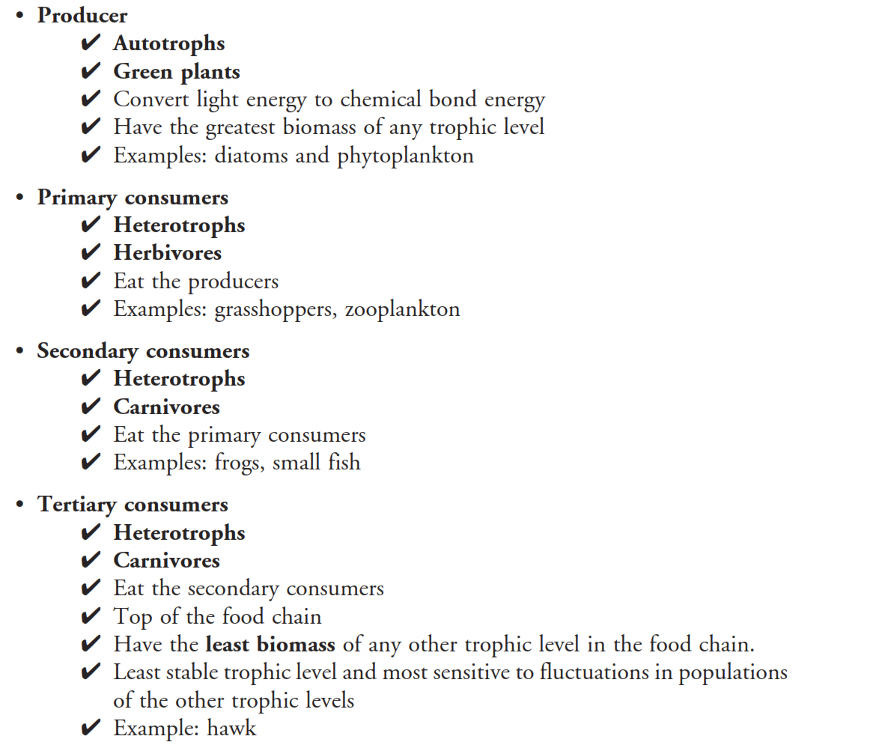
Diagram: Trophic Levels

Slide 21
Food Chains
Food chain - A linear path depicting a transfer of energy from the bottom of the trophic structure to the top.
Food chains are short. There are two main hypotheses for why that is.

Slide 22
Food chain Length: Energetic Hypothesis
Energetic Hypothesis - Inefficiency of energy transfer from one trophic level to another limits their length.
Experiments varying in the population of autotrophs support this hypothesis.
10% energy transfer between trophic levels.
For example, 100kg of plant biomass supports 10kg of herbivore biomass.
Biomass - Total mass of all individuals in a population.

Slide 23
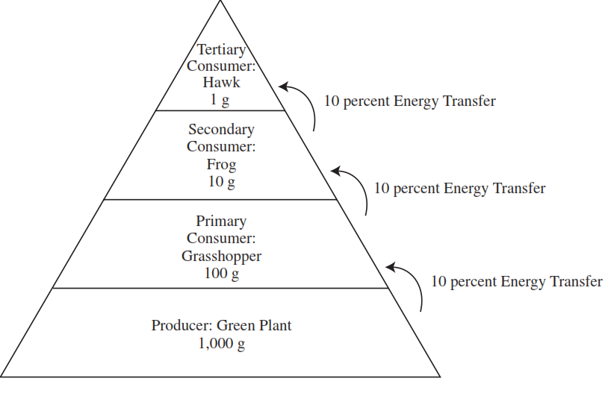
Diagram: 10% Energy Transfer

Slide 24
Food Chain Length: Dynamic stability hypothesis
Dynamic stability hypothesis - Longer chains are less stable. If population levels fluctuate at lower trophic levels, higher levels are affected greatly, possibly to the extent of local extinction. Shorter chains are naturally selected for.
If in a variable environment, predators at the top have to be able to adjust to events like blizzards/heat waves. The longer the chain, less of an ability to adjust due to more links in the chain that can be “broken”.

Slide 25
Structure: Food Webs
Food webs - Food chains are linked together in food webs, which shows the bigger picture of the community.
Several organisms interact with each other at different levels due to there being many different food chains.
Example: Krill being eaten by birds, crab eater seals, and Baleen whales.
If a portion of a food web interacts very little with the whole community, it can be isolated into a “mini” food web of sorts for study.

Slide 26
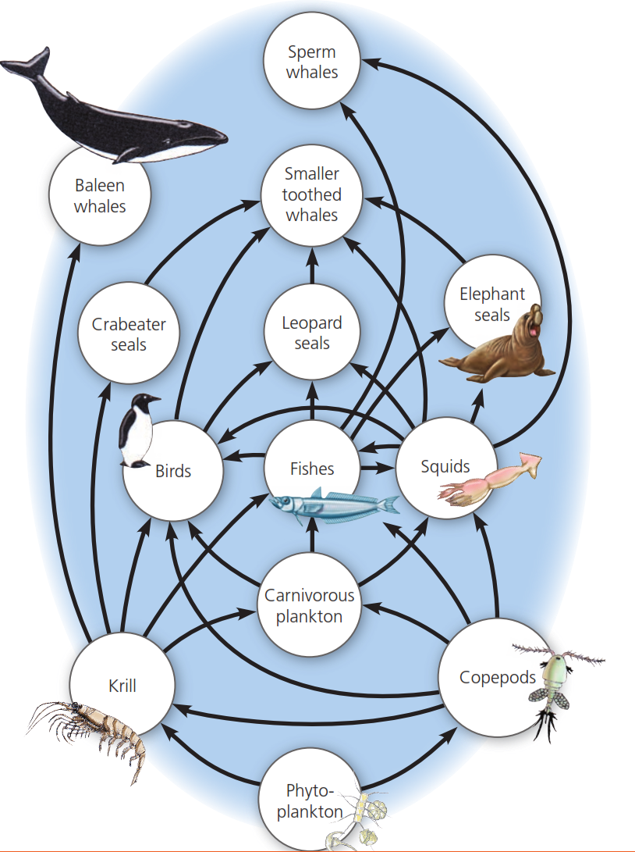
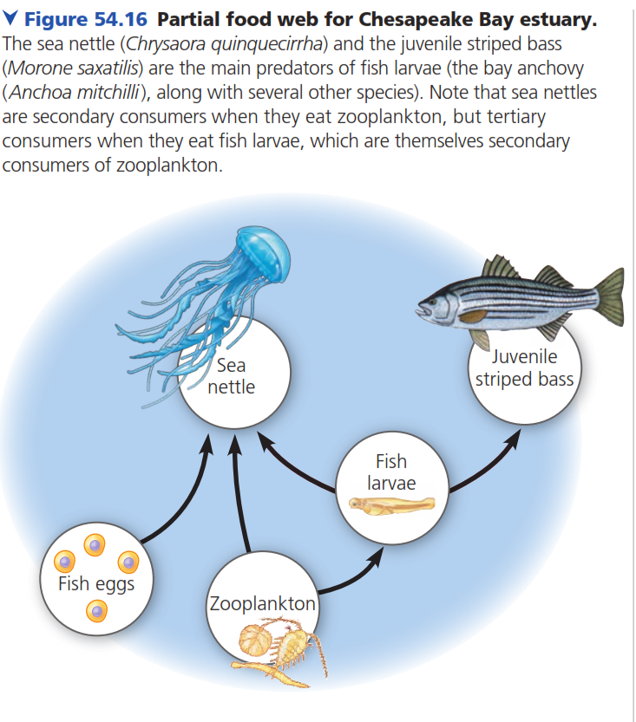
Diagram: Food Webs

Slide 27
Structure: Dominant Species
Dominant Species - Most abundant species in a community (biggest collective biomass).
Hypotheses for why they are the dominant species:
Superiority in attaining resources.
Less vulnerable to predation/disease.
Removal of dominant species is one way to see their impact.

Slide 28
Structure: Keystone Species
Keystone Species - Not abundant, but have a strong impact on the community due to their niches.
Example: Sea otters keeping the sea urchins who feed on kelp forests in check. Kelp forests helps to slow the effects of global warming.
Kelp forests that are protected from sea urchins absorb 12x more CO₂ than those that aren’t.

Slide 29
Structure: Foundation Species / Ecosystem Engineers
Ecosystem Engineers - “Foundation species” that dramatically alter their environment, and for other species that can be both negative or positive
Example: Humans. If we didn’t exist, and unless another species that has the equivalent of our intelligence arose in our absence, the world would be tremendously different today.

Slide 30
Modeling of Community Relationships
Bottom-up Model - Suggests an influence from lower trophic level to higher ones.
Example: As autotroph biomass increases/decreases, biomass of everything else increases/decreases too.
Top-down Model - Suggests an influence from higher trophic levels on lower ones. Manifests as an alternating +/- effect. Whoever begins the top-down model benefits, the next one suffers, the next one benefits, etc.
Example: Secondary consumer eats primary consumer, indirectly increasing producer population.
Has been used in applications of biomanipulation

Slide 31
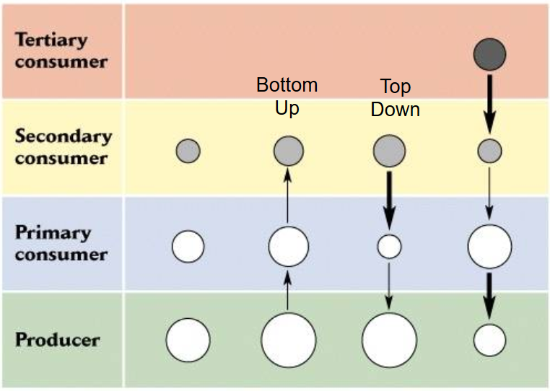

Slide 32
Biomanipulation
Biomanipulation - Artificial manipulation of an ecosystem by the removal or addition of a species.
Example: Polluted lakes. Removal of fish increases abundance of zooplankton, which consume the overabundant algae that are causing eutrophication, which essentially causes lack of O₂ due to the decomposers using up O₂ on dead algae.
The polluted lakes example uses a top-down model to determine that fish must be removed.

Slide 33
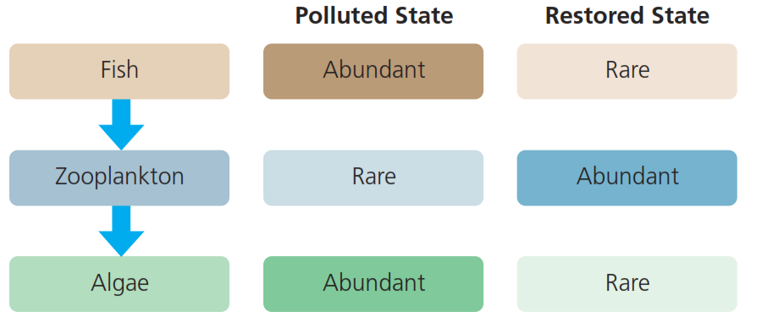
Diagram: Polluted Lakes and the Top-down Model

Slide 34
54.2: Summary
Diversity of a community is determined by how many species there are (richness) and how many of each species there are (abundance).
Indexes like Shannon’s Diversity can be used to quantify biodiversity.
More diverse communities are more stable to things such as sudden environmental changes and invasive species.
Trophic structure is made up of trophic levels
10% energy transfer to the next trophic level that’s above it.
Producers, primary consumers, secondary consumers, and tertiary consumers.
Decomposers recycle everything and allows for the cycle of energy transfer to begin again.
Food webs are made up of food chains that interact with each other in some way.
Shorter food chains tend to be more stable.
Dominant species are the most abundant species in a community.
Keystone species aren’t the most abundant, but they have impactful niches like the dominant species.
Ecosystem engineers are species that dramatically alter their environment in some way.
Bottom-up and Top-down models suggest influences from the bottom trophic levels to the top and from the top to the bottom, respectively.
Used in applications of biomanipulation, or the artificial manipulation of an ecosystem.

Slide 35
General Ecology Terms
A population is a group of individuals of one species living in one area who have the ability of interbreeding and interacting with each other.
Example: Populations of humans, populations of black oaks, and populations of the bacteria Streptococcus pneumoniae.
A community consists of all the organisms living in one area.
An ecosystem includes all the organisms in a given area and the abiotic (nonliving) factors with which they interact.
Abiotic factors are nonliving and include temperature, water, sunlight, wind, rocks, and soil.
The habitat of an organism is the type of place where it usually lives. A description of the habitat may include other organisms that live there (often the dominant vegetation) as well as the physical and chemical characteristics of the environment (such as temperature, soil quality, or water salinity).

Slide 36
Sources:
Campbell Biology / Edition 11 by Lisa A. Urry, Michael L. Cain, Steven A. Wasserman, Peter V. Minorsky, Jane B. Reece
Campbell Biology / Edition 9 by Lisa A. Urry, Michael L. Cain, Steven A. Wasserman, Peter V. Minorsky, Jane B. Reece
Barron's AP Biology, 5th Edition by Deborah T. Goldberg M.S.
CliffsNotes AP Biology, Third Edition by Phillip E. Pack
http://www.uky.edu/Classes/ENT/530/Lecture_Notes/feb11/feb11_files/frame.htm
http://ocean.si.edu/ocean-news/5-invasive-species-you-should-know
http://news.ucsc.edu/2012/09/sea-otters-kelp.html

